Slide 1

Web Project for Exchange Student
SKKUEXS
김주원 | 서현원 | 이하은 | 한희근

Slide 2
Weekly Progress

Slide 3
Schedule
To – do Week | 3 | 4 | 5 | 6 | 7 | 8 | 9 | 10 | 11 | 12 | 13
Proposal & Study
Data Collecting
Data Processing (NLP)
Front-end (Planning & UI/UX)
Back-end (Server & DB Design)
Beta Test
3

Slide 4
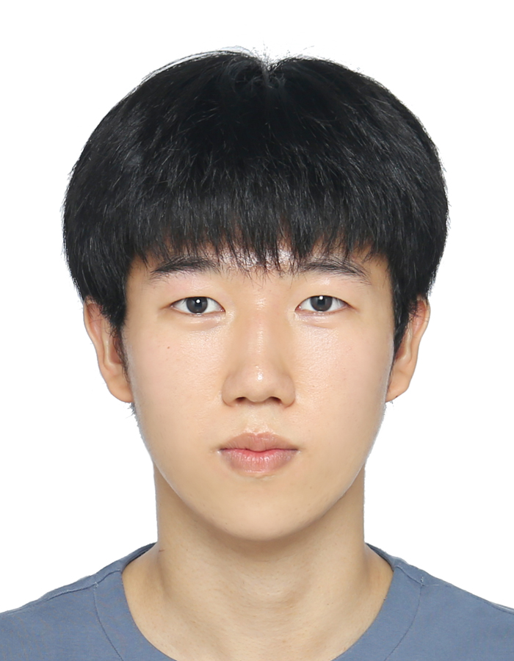
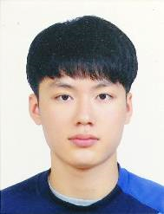

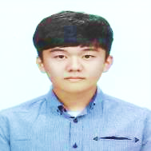
Work Assignment
Juwon Kim
Data Processing(.hwp)
Hyunwon Seo
Data Processing(.pdf)
Haeun Lee
Data Processing(.doc)
Huigeun Han
Web Crawling
4

Slide 5

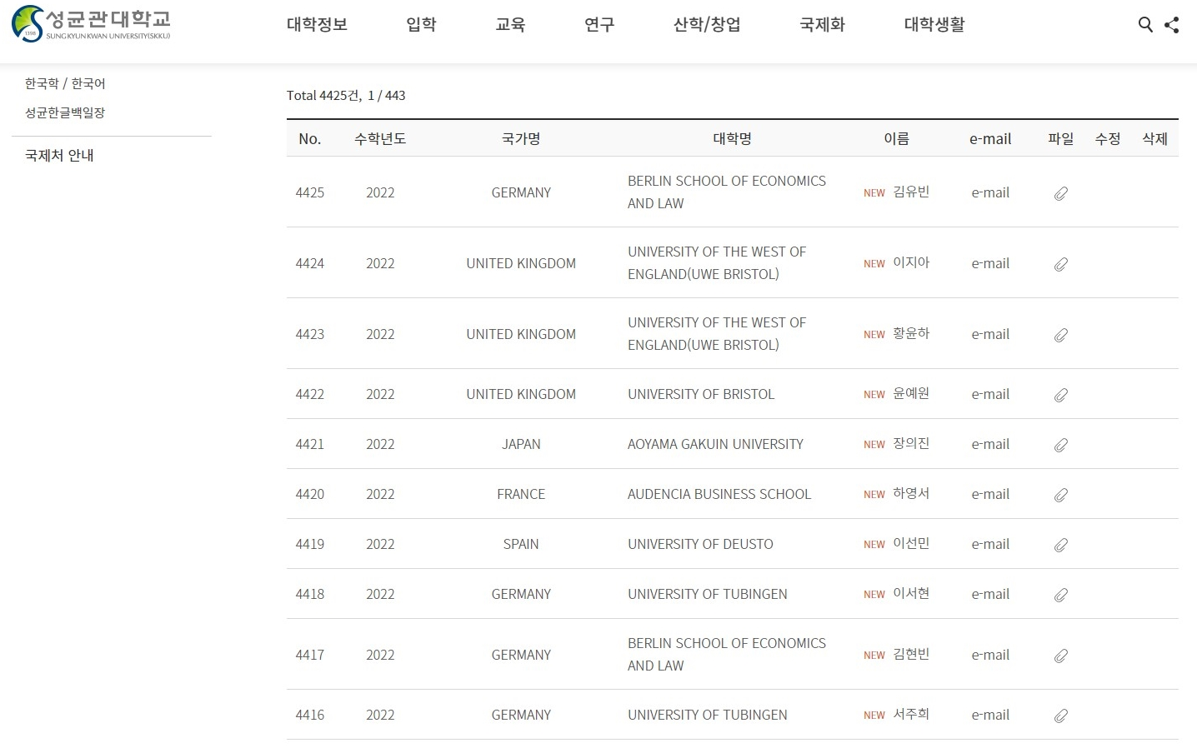
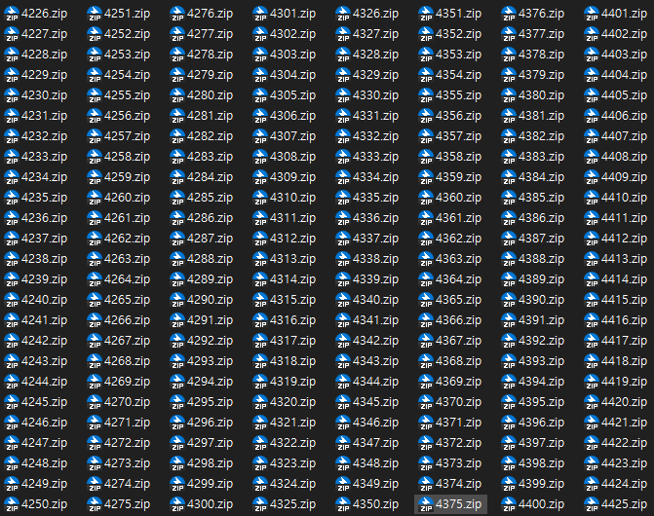
Web Crawling
Total 4,425
By
5

Slide 6
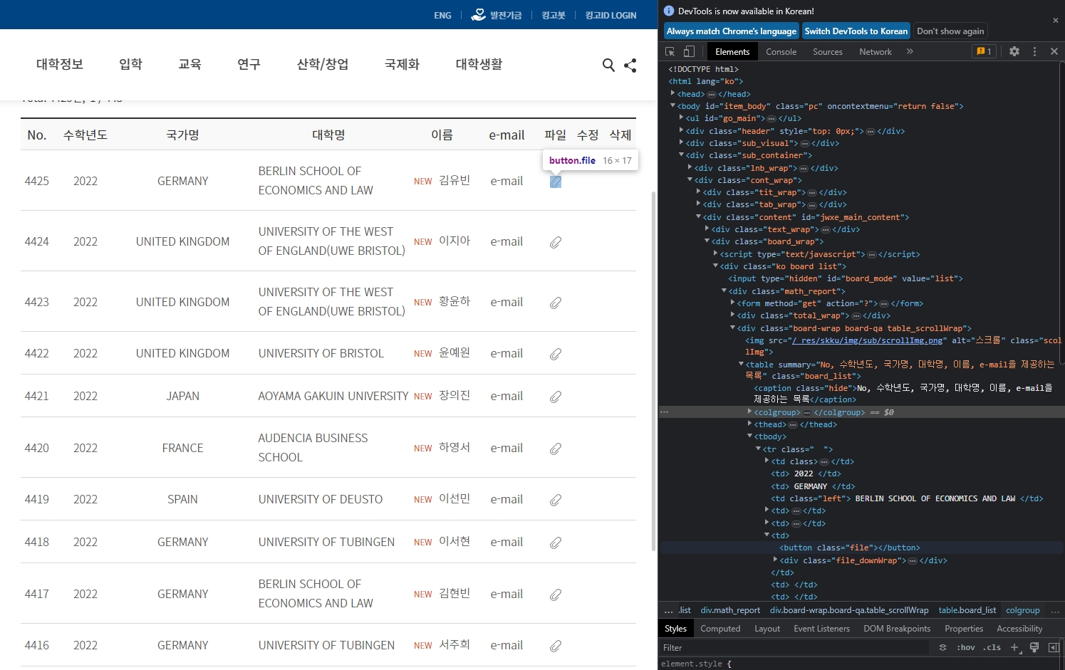
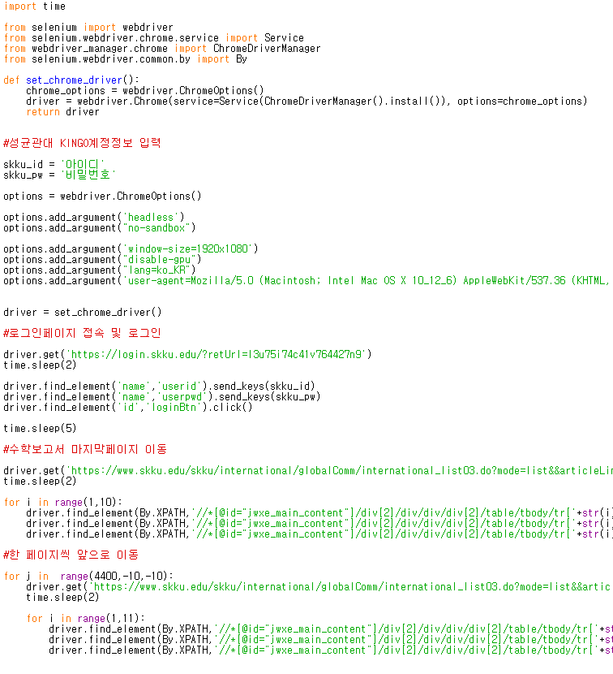
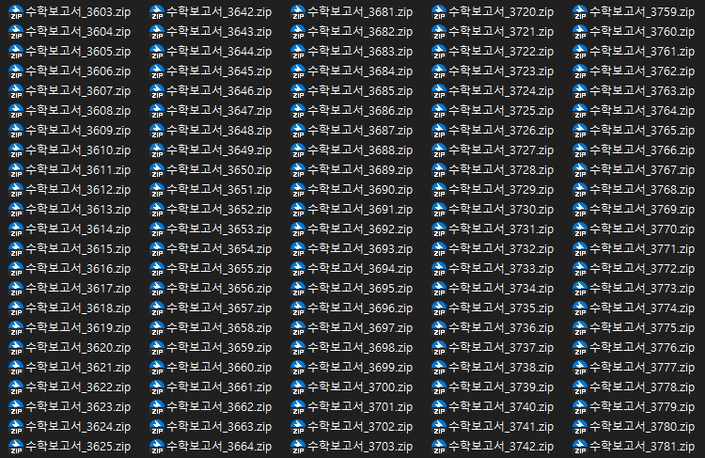
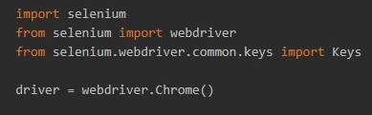
Web Crawling
find_element_by_xpath(‘//*[@id=...’).click()
from selenium.webdriver.common.by
import By
find_element(By.XPATH,‘//*[@id=...’).click()
6

Slide 7
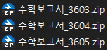
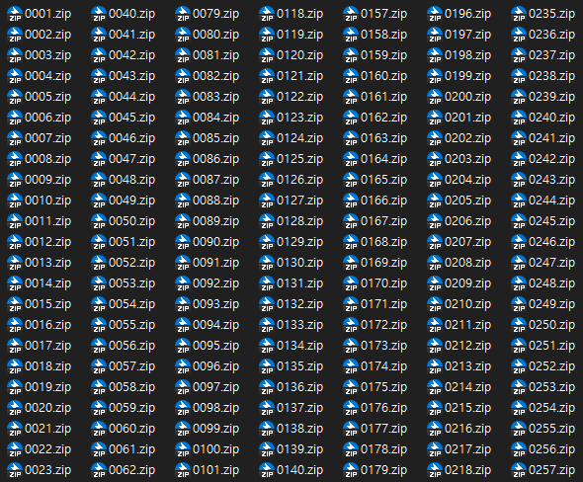
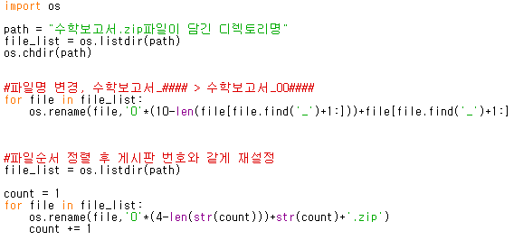
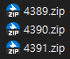
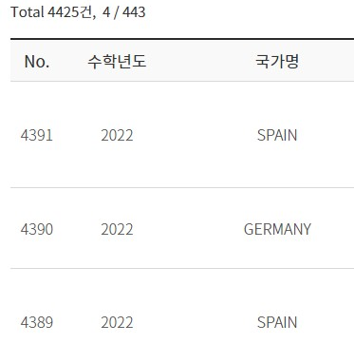
Web Crawling
수학보고서_100001.zip
...
수학보고서_003603.zip
...
수학보고서_099997.zip
0001.zip
...
4106.zip
4107.zip
...
수학보고서_100001.zip
...
수학보고서_3603.zip
...
수학보고서_99997.zip
수학보고서_003603.zip
...
수학보고서_099997.zip
...
수학보고서_100001.zip
7

Slide 8
Data processing
8

Slide 9
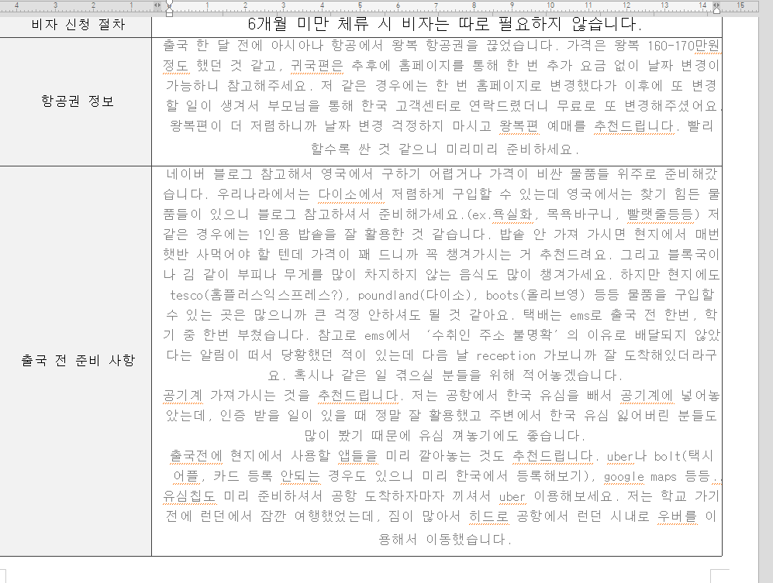
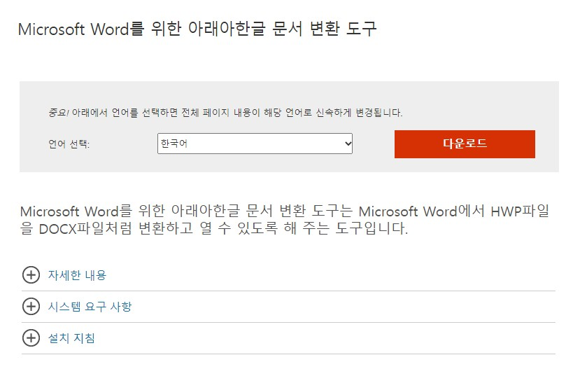
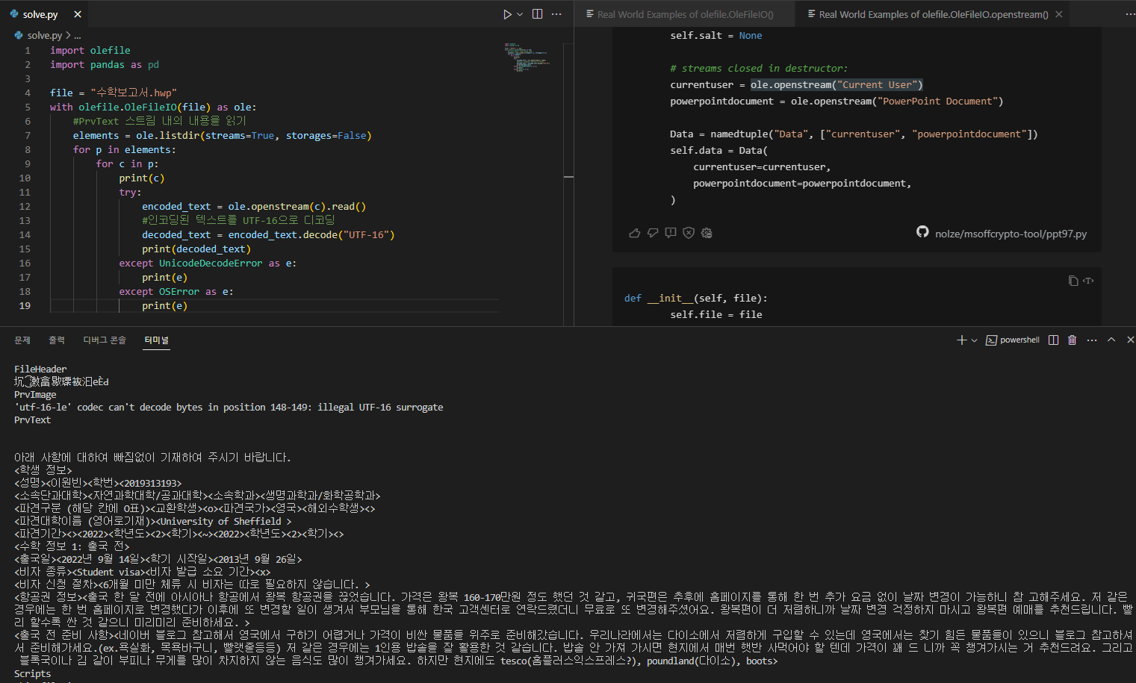
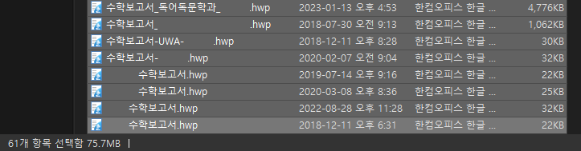
Data processing (.hwp)
9

Slide 10
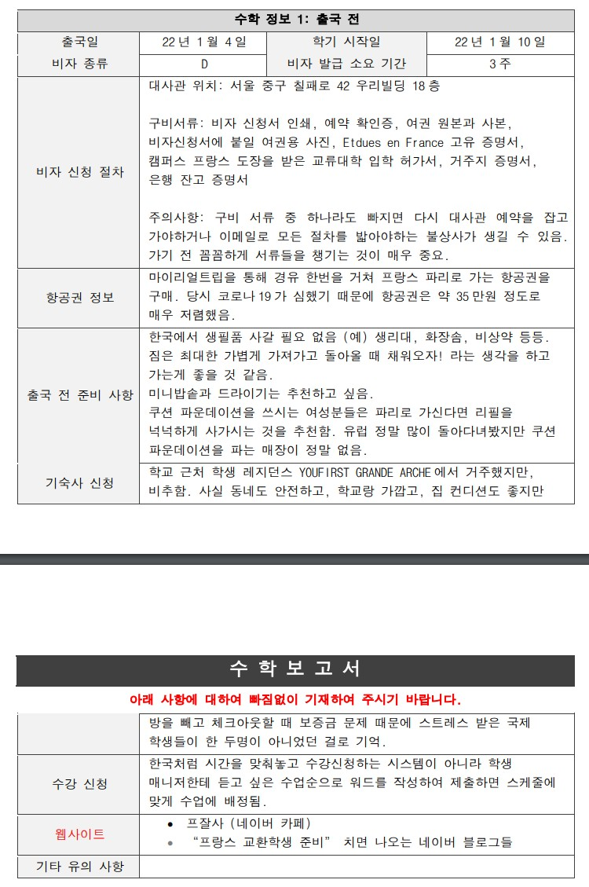
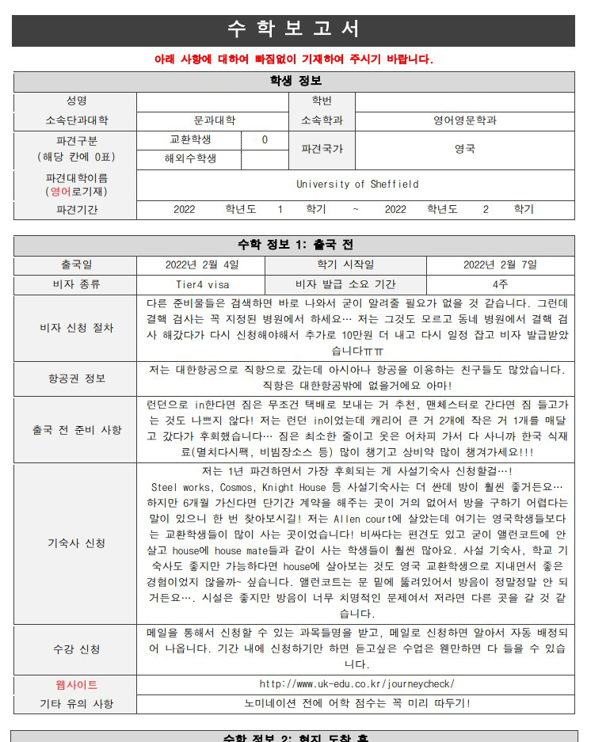
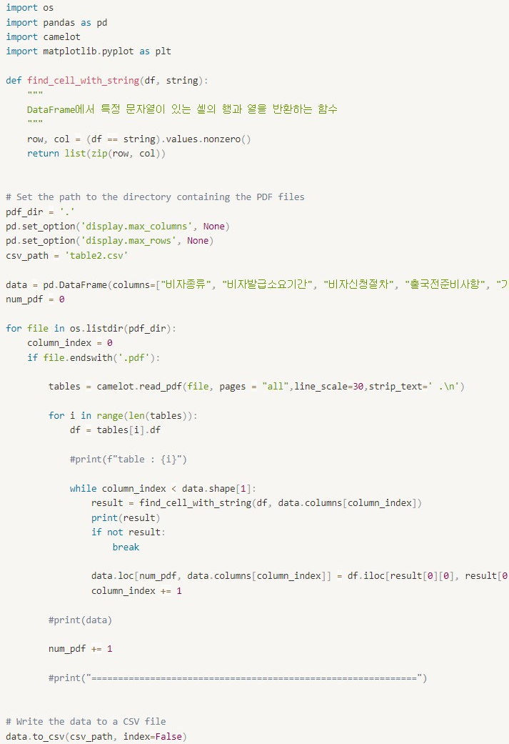
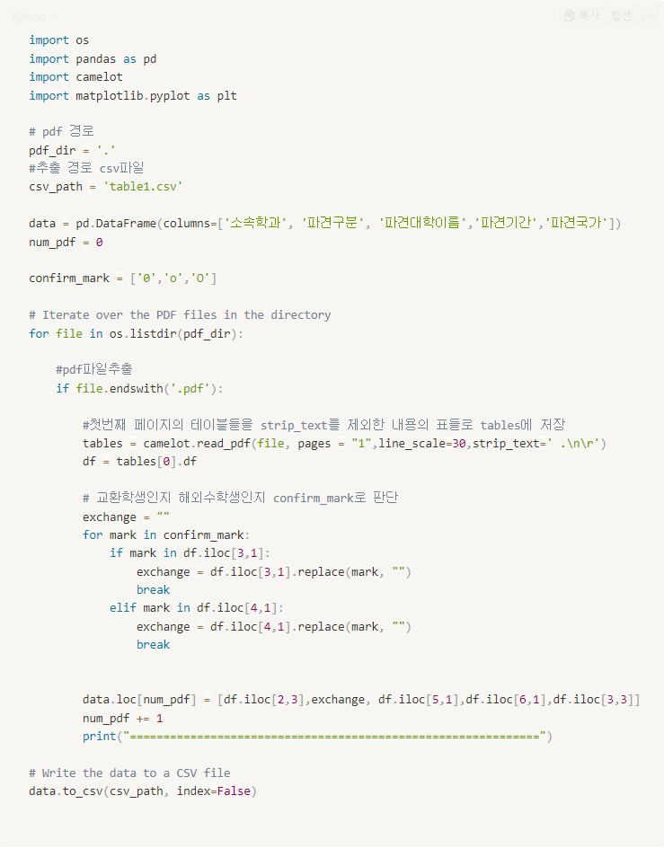
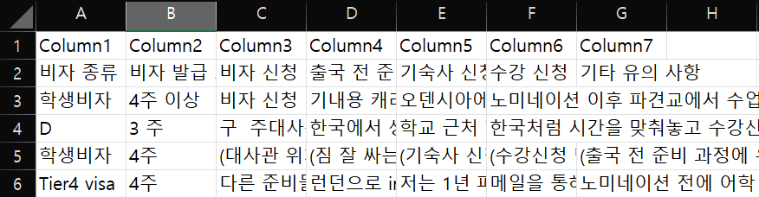
Data processing (.pdf)
10

Slide 11
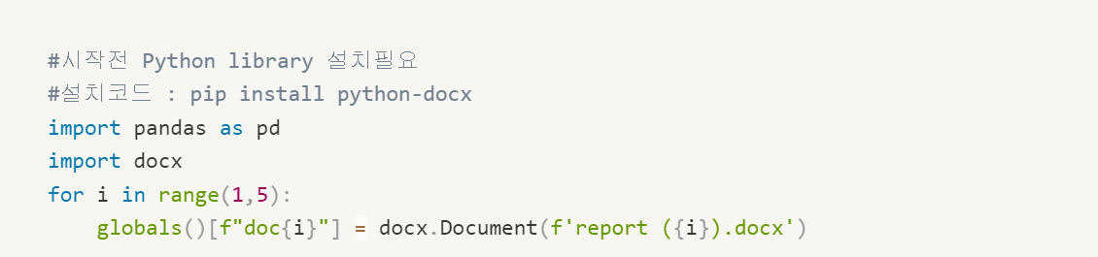
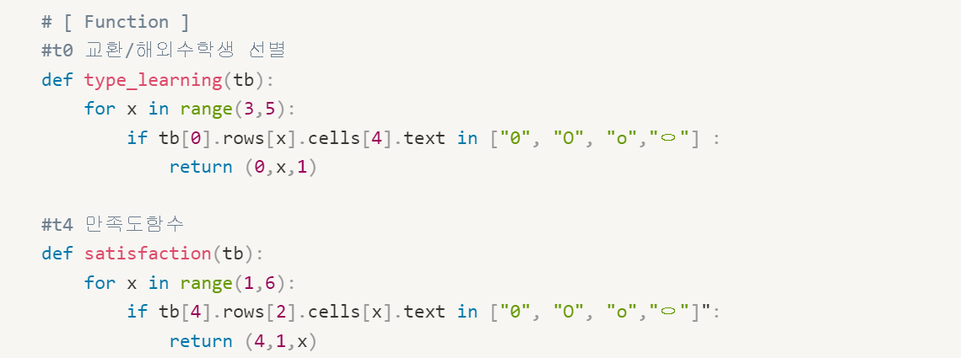
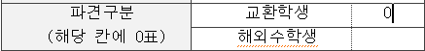
Data processing (.docx)
Pandas, docx library import
Make Some Function
11

Slide 12
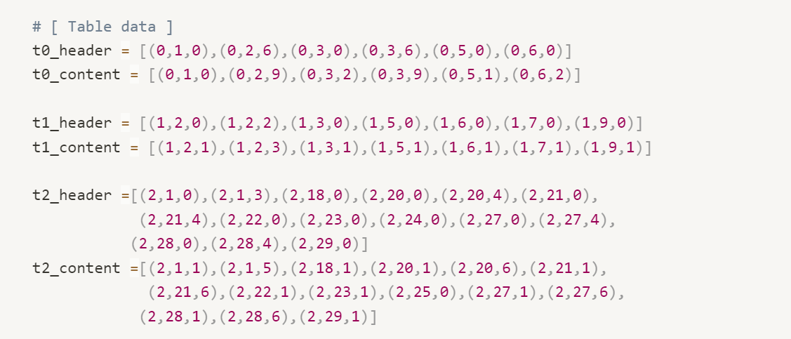
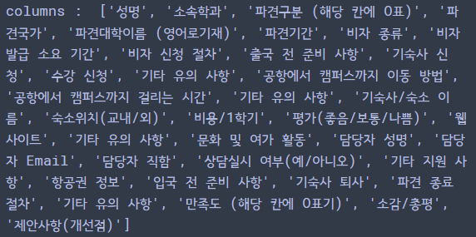
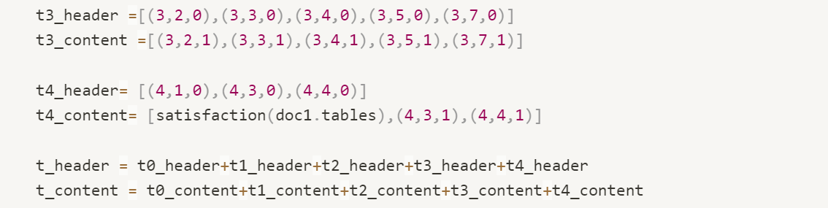
Data processing (.docx)
Table Data Selection
12

Slide 13
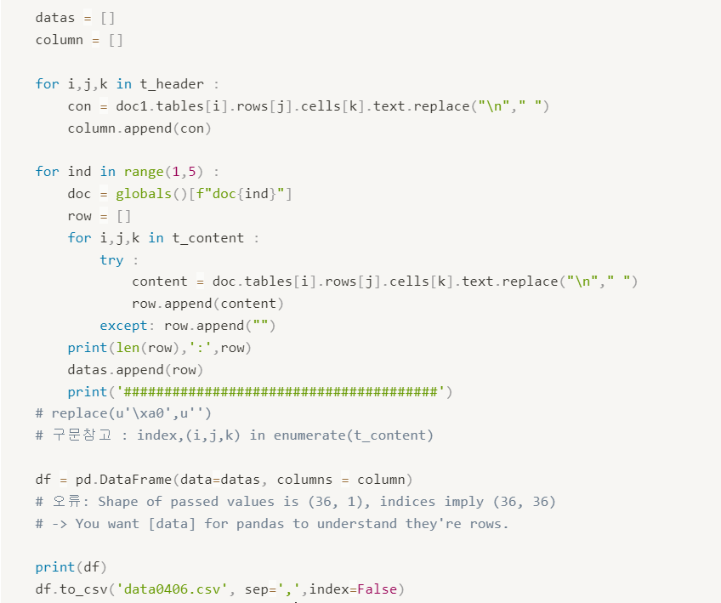
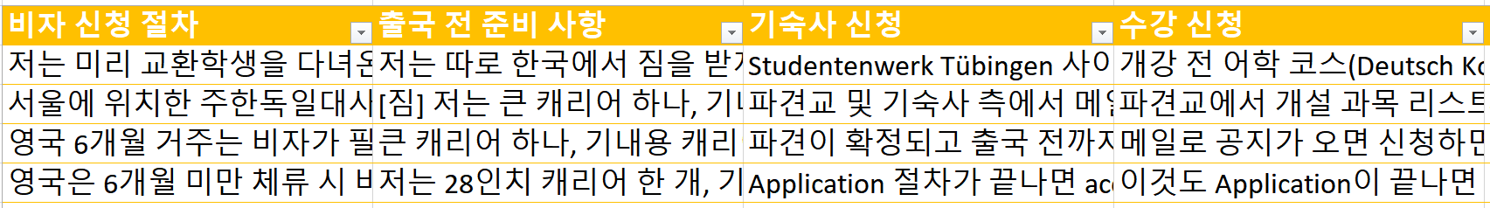
Data processing (.docx)
Append Data to
Column & Row
Make DataFrame
Save it to CSV
13

Slide 14
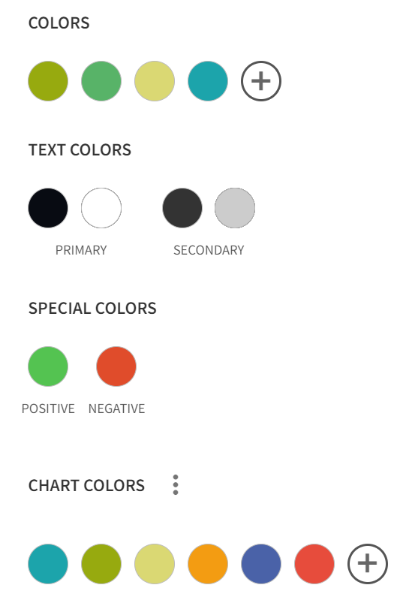
Database will contain..
36
Columns
14

Slide 15
What we‘ve Learned..

Slide 16
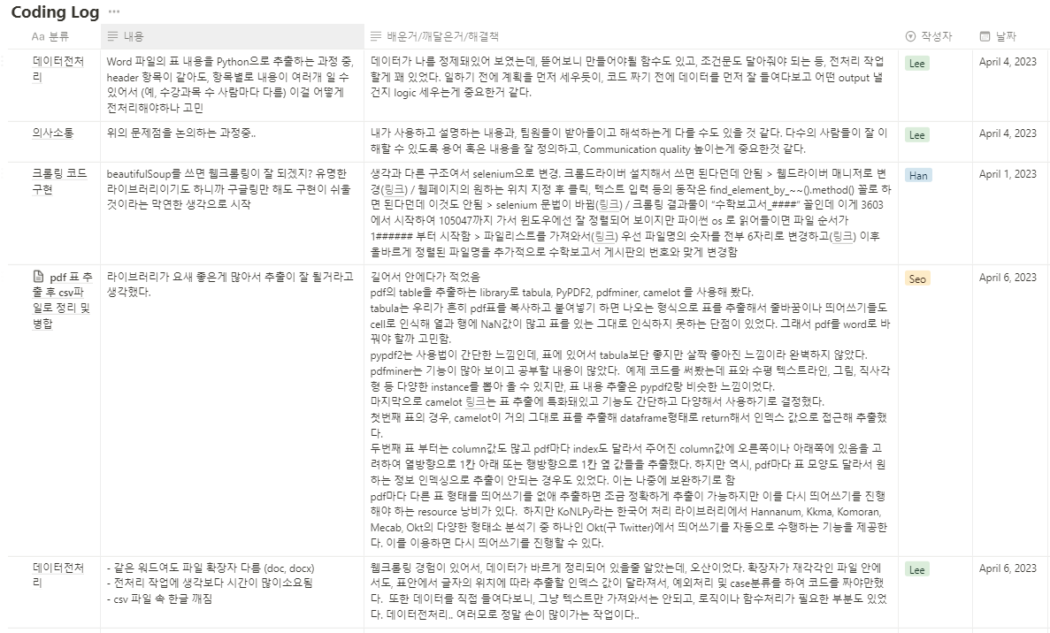
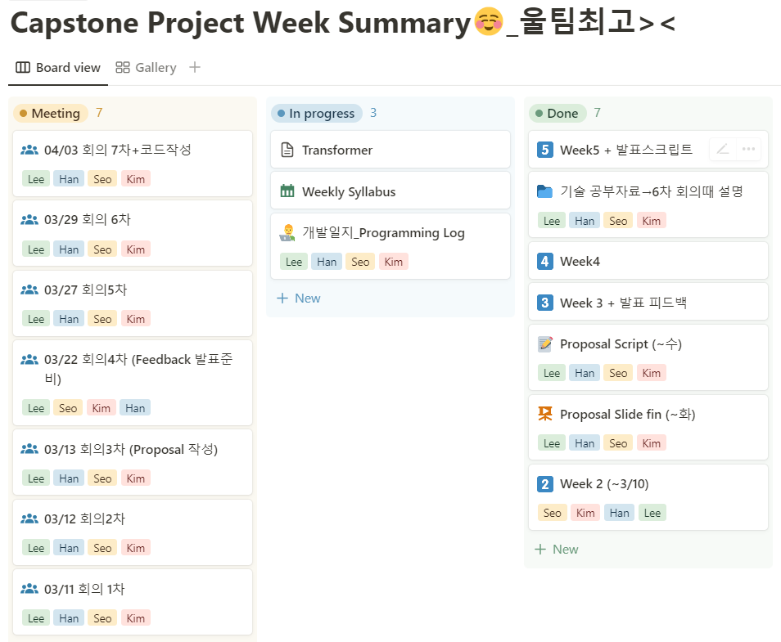
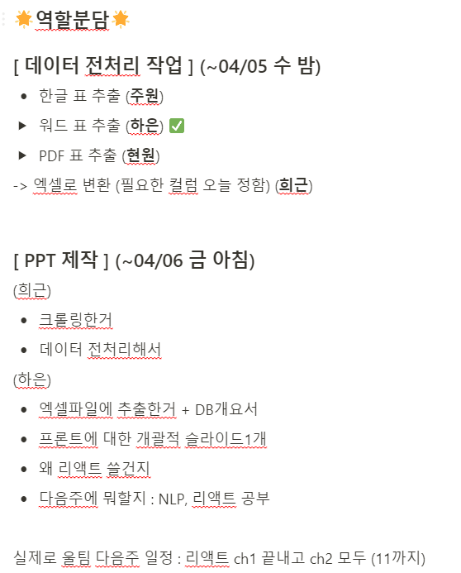
16

Slide 17



What we‘ve Learned..
Communication
Data Outline
Library isn’t God
Impt in Decision making Use suitable words
See the forest first Make a goal and logic
Real data is different each other and just knowing library cannot be helpful

Slide 18
What we’ll do next..

Slide 19
Next Week Plan
Section 1
NLP
Study React
Project Overview
Keyword Extraction
Text Summarization of review comments
Study React basic
19

Slide 20
Reference
Crawling https://velog.io/@sangyeon217/deprecation-warning-executablepath-has-been-deprecated https://velog.io/@thovy/selenium-AttributeError-Webdriver-object-has-no-attribute-findelementbyidhttps://itholic.github.io/python-listdir-glob/ https://www.techiedelight.com/ko/how-to-rename-a-file-in-python/
add more reference
20

Slide 21
Q&A

